Slide 1
Current: $744.12 Target: $982.15 (+24.24%) Time Horizon: 12-24 Months
Tesla Inc.
(NASDAQ: TSLA)
Industry Director: Ray Hatton
Analysts: Benjamin Chan, Bricen Fisher, Nirmal Malhotra
Junior Analyst: Kat Berezovsky, Keegan Snyder

Slide 2
Company Overview
Business Description
Revenue Estimates ($B)
TSLA was formed in 2003 by Elon Musk and 5 other founders
TSLA is located in the Bay Area and has manufactures in Fremont, Shanghai, and Berlin
World’s largest EV manufacturer and distributer, accounting for 80% EVs sold in the U.S. in 2020
The 5th most innovative company in 2021
Tesla short sellers lost $40.1B in 2020
TSLA has 70,000 employees (+50% YoY)
Business Highlights
Revenue Breakdown
$0.00 spent on advertising where competitors in the auto industry advertising expenses are expected to be $13B in 2021 growing at a 13% CAGR from 2011 to 2021
Fremont increased capacity for Model S and X
Shanghai has stable Model 3 production at 250K vehicles/year with increased production at 550K vehicles in 2020
Despite the pandemic, Tesla’s electric car shipments reached close to 500K (+36% YoY)
Sources: Electrek, BCG, Company Financials, Yahoo Finance, CAPIQ, Forbes, Statista

Slide 3
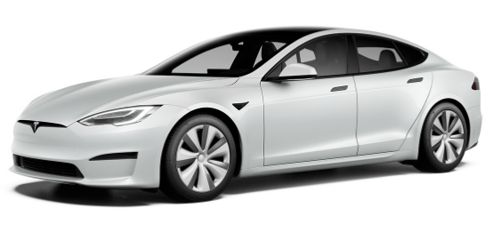
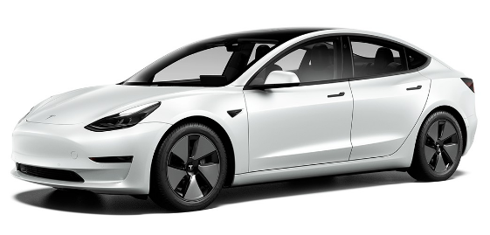
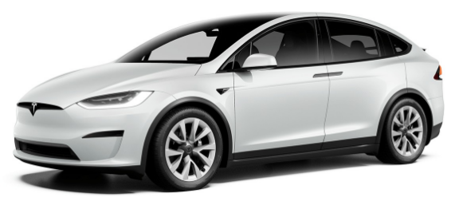
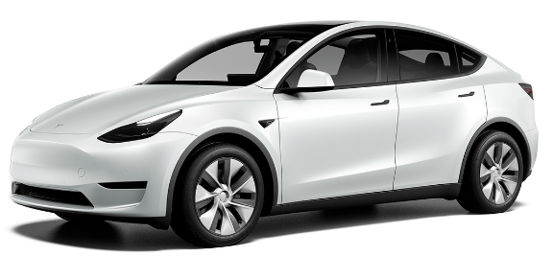
Flagship Vehicle Segment Overview
Model S
Model 3
Model X
Model Y
Autopilot & Full Self Driving (FSD)
2020’s 5th most sold EV
Accounts for the 15th and 16th top cars for combined MPG
Made of aluminum
5-seater
Plaid+
520 mile range
<1.99 0s – 60s
200mph top speed
1,100+ hp peak power
28 cu ft cargo
Autopilot & FSD
2020’s 1st most sold EV
Top 4 vehicles for combined City and Highway MPG
Made of steel and aluminum
5-seater
Performance
315 mile range
3.1s 0s – 60s
140mph top speed
480 hp peak power
15 cu ft cargo
Autopilot & FSD
2020’s 4th most sold EV
Accounts for the 35th, 36th, 49th, and 50th vehicle for combined MPG
Made of steel and aluminum
7-seater
Plaid
340 mile range
2.50s 0s – 60s
163mph top speed
1,020 hp peak power
88 cu ft cargo space
Towing 5,000 lbs
Autopilot & FSD
2020’s 2nd most sold EV
Account for the 7th, 8th, 9th, 10th top vehicles for combined MPG
Made of steel and aluminum
7-seater
Performance
303 mile range
3.5s 0s – 60s
155mph top speed
497 HP
68 cu ft cargo space
Sources: Company Website, Electrek, U.S. Department of Energy, Evcompare.io

Slide 4
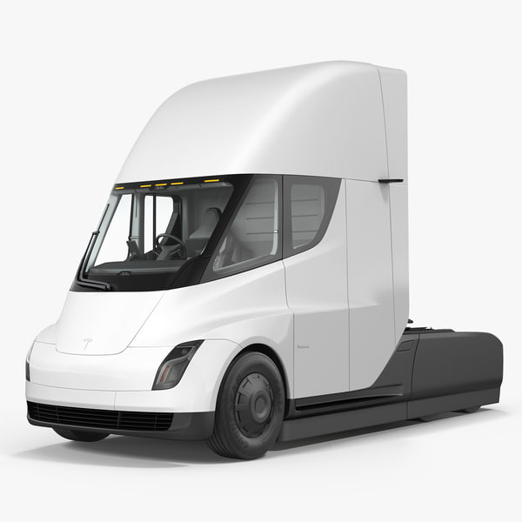
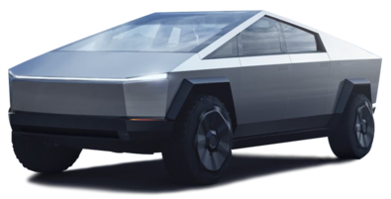
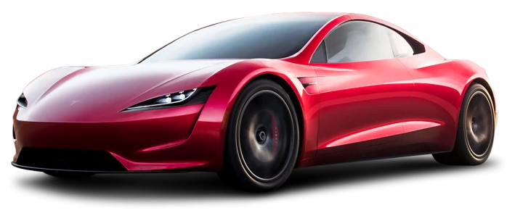
Innovative Vehicle Segment Overview
Cybertruck
Roadster
Semi
Autopilot & FSD
700K+ pre-orders
Ultra-hard 30X cold-rolled stainless-steel exoskeleton & armor glass
5/6-seater
The interior is equipped with a 17-inch touchscreen
Tri Motor AWD
500+ mile range
<2.9s 0s – 60s
16 inch ground clearance
1,400+ lbs towing capacity
100 cu ft cargo
Autopilot & FSD
1K max vehicles available for pre-orders
1st supercar to set every performance record
4-seater
AWD base
620+ mile range
<1.9s 0s – 60s
<4.2s 0s – 100s
¼ mile in 8.9 seconds
250+ mph top speed
200 kWh battery pack
Enhanced Autopilot & FSD
2K pre-orders
AWD base
300 - 500 mile range
<20s 0s – 60s
65 mph up 5% grade
<2 kWh/mi energy consumption
¼ mile in 8.9 seconds
250+ mph top speed
200 kWh battery pack
Sources: Company Website, Yahoo Finance, Cnet, Market Watch

Slide 5
Financial Overview
52 Week Price Change
Enterprise Value Walkthrough
5
$ in Millions
Share Price | $744.12. | $714,246
Shares Outstanding | 959.9. | 959,853,504
Equity Value | $714,246. | $706,645
Cash & Short-Term Investments | 19,384. | 19,384
Total Debt | 10,329. | 10,329
Preferred Equity | -. | -
Minority Interest | 1,454 . | 1,454
Enterprise Value |  | $706,645.
1
$744.12
3
4
2
Financial Highlights
Key Metrics
TSLA included in the S&P 500 as 6th largest member
TSLA market capitalization crosses $500B for the first time
TSLA delivers on 500k customer deliveries exceeding consensus estimations
TSLA Chinese sales more than doubled in 2020
Cathie Woods (ARK Investment Management) upgrades TSLA to a $3,000 price target by 2025
Market Cap | $649.84B
52 Week Range | $116.11 - $900.40
EV/LTM EBITDA | 151.82x
LTM Gross Profit Margin | 21.20x
LTM P/E | 990.63x
Beta | 1.60
Sources: Yahoo Finance, CAPIQ, CNBC

Slide 6
Industry Overview
Electric Vehicles (EVs)
EV Sales in 2020 by Country
Global EV market is expected to reach $803B by 2027 growing at a 23% CAGR
In 2018, 45% of global EVs related to China
China’s expected to produce 60% of passenger EVs and 65% of lithium-ion batteries by 2021
3M Americans are employed in auto space with 1M in in motor vehicle manufacturing, and 250k in EV space
Batteries comprise ~30% of parts in an EV
Biden & Global Infrastructure
U.S. State and Federal Policies
$300B estimates to advance global charging network, with U.S. pushing $50B for by 2030
Biden’s infrastructure plan contains $115B+ related solely to EV expansion efforts
Biden’s 2030 goal for 500K chargers, 20% of school busses electric, replace 50k diesels
Federal tax credit of $7,500 would no longer be capped to the first 250k EVs of a manufacturer
Certain tax breaks would be for domestic manufacturers hurting imported EV brands
Sources: Investopedia, Allied Market Research, weforum, Statista, CNBC

Slide 7
Investment Thesis
Factories Help Meet Production Deadlines
Vertically Integrated 4680 Cells Increase Range and Increase Pricing Power
FSD Beta and Supercharging Attract Consumers
Strong Customer Loyalty and Renewable Sector Aid Company Growth

Slide 8
Investment Rationale
Tesla’s new factories boost production to capture surplus demand of S3XY CARS
Model 3 and Model Y made up 89% of overall sales with Model S and Model X making up 11% sales
Customers waiting 9 to 13 weeks for delivery while other brands have cars on lot equate high demand
New factories will aid in delivery deadlines and in global expansion with output increase of +100%
Cybertruck 700K+ preorders outstanding being 31% cheaper than runner up ICE vehicle, and the next generation design will bring strong revenues
Tesla’s 4680 cells and in house battery production will curb future bottlenecks
Tesla has acquired 10K+ acres of land to mine lithium in Nevada so it’s not reliant on other sources such as South America or China
New cells are 56% cheaper to produce and 54% more dense than existing 2170 cells used today
Vertical integration of battery manufacturing and new cell tech will lead to better pricing power
Batteries are the most expensive part in EVs, reduced costs lead to more affordable models
Tesla Factory Predicted Output
Worldwide Lithium Demand LCE
CAGR 27.7%
Sources: Investor Presentation, Tesla.com, Statista, CNBC

Slide 9
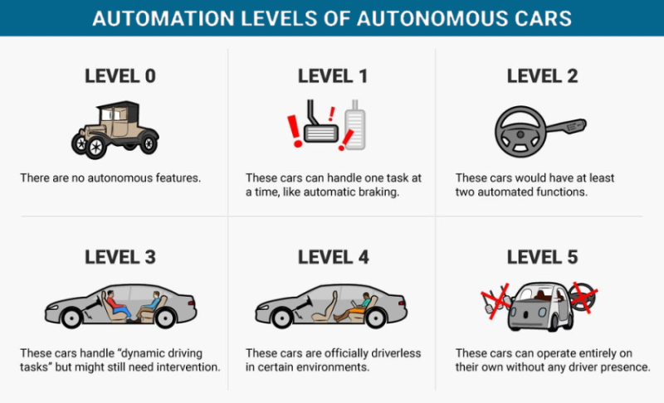
Investment Rationale
Tesla FSD Beta places them as market leaders
Waymo vs. Tesla FSD resulted in Tesla’s trip being ~60% faster, more precise, and realistic as well
FSD Beta will enable a driver to go to a destination with little to no intervention but requires driver
OTA software unlock costs 10K+ or subscription will create revenue from pre-existing vehicles
Car uses cameras onboard and can adapt to any environment relative to competitors such as GM’s super cruise and Waymo needing mapped roads
Robotaxi service will cost 45% per mile less than today’s Lyft or Uber service and be an OTA update
Tesla’s proprietary solar and battery pack solutions attract loyal and new customers
Solar panels made in GigaNewYork allow Tesla to evade tariffs as the U.S. centralizes supply chains
Tesla reached a deal with Apple to supply 85+ energy megapacks for a large solar energy farm
Solar price match in addition to innovative energy storage solutions equates to rise in market share
Proprietary solar roof is cheaper than new roof & solar panels at $2.01 per watt vs $2.85 per watt
Levels of Autonomy
U.S. Solar Capacity (Gigawatts)
CAGR 8.7%
Sources: CNBC, Statista

Slide 10
Investment Rationale
Tesla’s expansive, intuitive, and consistent supercharging network provides an advantage
Superchargers are exclusive to Tesla vehicles
Average of 9 superchargers capable of charging 2 vehicles means 48K+ charging spots globally
Once Tesla account is setup, the process is plug and go which other charging stations can’t do
V3 superchargers provide charging speeds up to a 1000 miles an hour, or 5% to 90% in 37 minutes
Consistent and convenient charging stations will lead to increased revenue and market share
Tesla’s loyal fanbase will propel the company forward and create sticky revenue in long term
Elon Musk, the Techno King of Tesla is a visionary with innovative products has created a fanbase
98% of Model 3 owners would buy another Tesla, and 99% would refer family & friends to Tesla cars
Online purchasing has drawn people to Tesla as no need for a chaotic dealer atmosphere is needed
Referral program has had great success and has significantly contributed to 100% organic growth
Tesla’s Supercharger Station Globally
CAGR 93.7%
Reddit Following by Brand
Sources: Supercharge.info, Forbes, Insider, Bloomberg

Slide 11
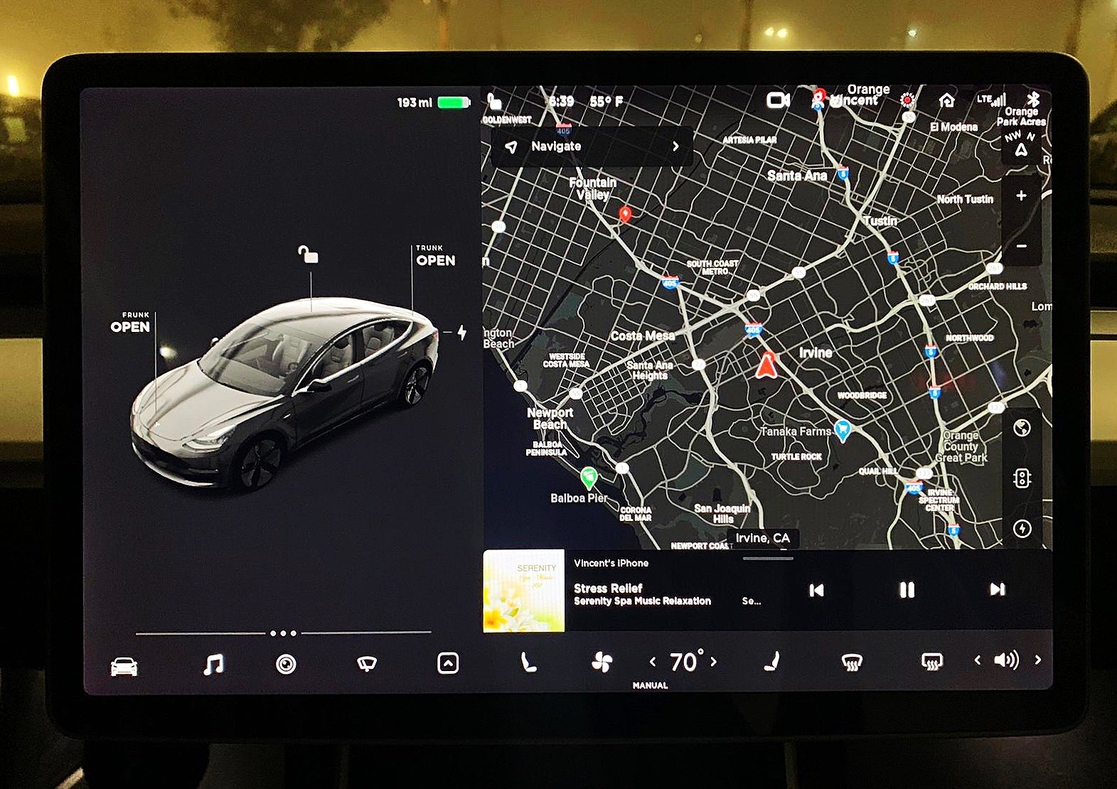
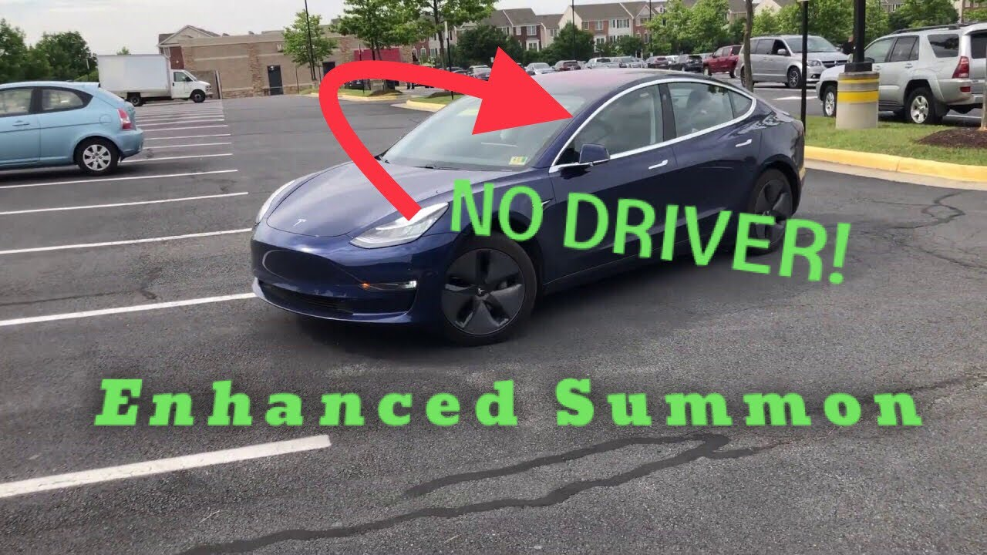
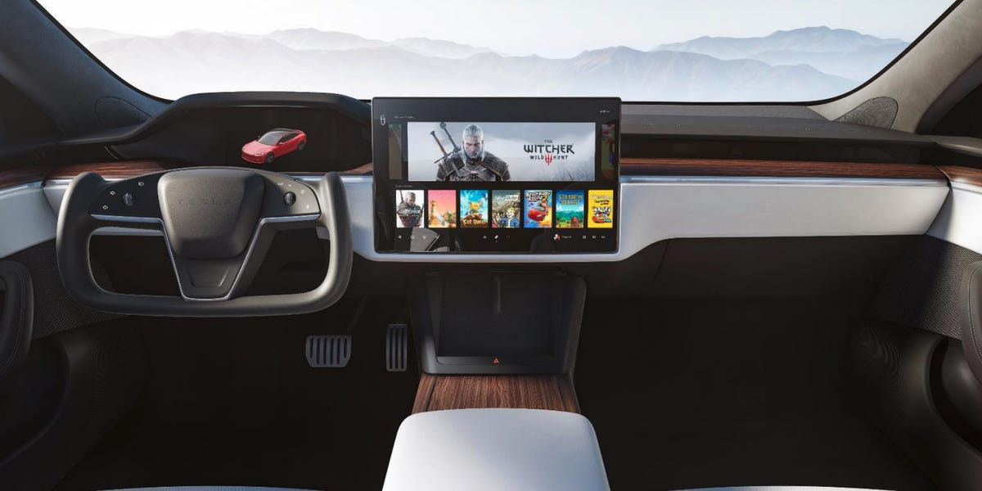
Competitive Advantage
Why Consumers Love Tesla
OTA software updates allow the vehicle to be better than the first day of delivery with features
Responsive and an intuitive user interface sets Tesla apart as other car companies consolidate move to Apple Carplay & Android Auto
Consumers can use their cell phone as their key and don’t have to deal with clunky key chains
Features like Smart Summon, Boombox, Tesla Arcade & Theater give unique exposure
All Tesla’s share the same basic UI and have only one software package which is FSD Beta
Sources: Tesla, All Electric

Slide 12


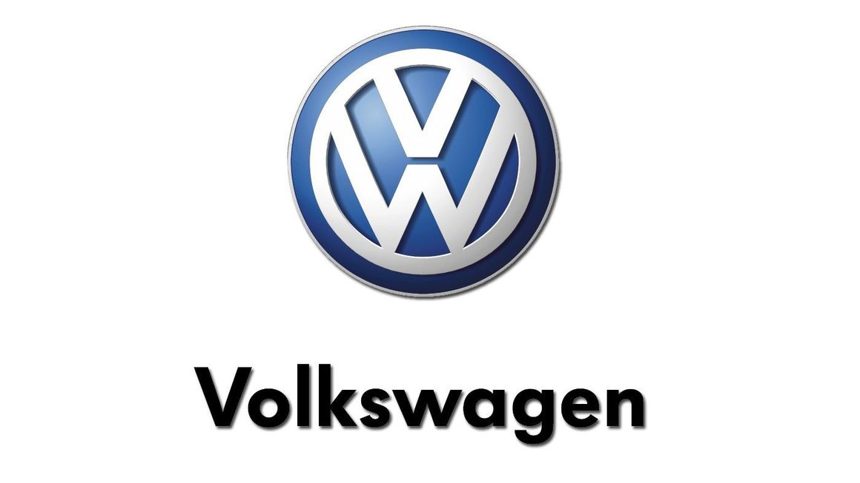
Competitive Landscape
Mkt Cap | $62B
Net Income | ($5B)
Beta | 2.61
Mkt Cap | $84B
Net Income | $6B
Beta | 1.39
Mkt Cap | $131B
Net Income | $8B
Beta | 1.51
NIO designs, manufactures, and sells EV’s in China, the U.S., the UK, and Germany
In China, NIO only has 160 battery-swapping stations while Tesla has 730 supercharging stations
NIO has a single factory which is based in China
Tesla’s sales in China were +200% greater than NIO’s
NIO faced bankruptcy in 2019 and was bailed out by government cash injection
GM is an American multinational corporation that designs, manufactures, markets, and distributes vehicles & parts for vehicles
GM’s joint ventures, primarily in China, give the automaker limited control over business decisions and benefits
GM’s R&D expenses decreased by 8% compared to Tesla’s who's increased by 11%
In Q4 of 2020, GM recalled tens of thousands of all-electric Chevrolet Bolt’s due to risk of fire
Volkswagen is a global leader in the manufacturing of automobiles and commercial vehicles
VW had 11% global EV market share in 2020, over 2x less than Tesla’s 23% position
VW’s reputation was damaged by a diesel emissions scandal that emerged in 2015
VW’s Electrify America Network is tedious and complicated in comparison to Teslas supercharging network
Sources: CAPIQ, Forbes, InsideEVs, Nikkei Asia, SEC Filings, Statista

Slide 13
Public Benchmark
LTM Revenue Growth (%)
Gross Margin
Median: 2.4%
Median: 16.5%
LTM Capex Growth (%)
Debt / LTM EBITDA
Median: (20.8%)
Median: 7.4x
Sources: CAPIQ

Slide 14
Public Comparable

Slide 15
Discounted Cash Flow

Slide 16
Discounted Cash Flow Output

Slide 17
Potential Risks & Mitigants
Tesla faces increased competition for similar products and services from a growing list of established and new competitors
Mitigant: Tesla has an exclusive network of supercharging stations that solve an obstacle that many other EV manufacturers have yet to successfully address – widespread fueling accessibility
Mitigant: Tesla continues to enjoy high consumer demand that is driven by modern design, innovative technology, and high performance
Mitigant: Tesla has the most loyal customers of any car company with 73% of Tesla customers returning to buy/lease Teslas after they dispose of their present ones
Any supply chain disruptions related to lithium-ion cells may lead to bottlenecks
Mitigant: Tesla has a diverse and reliable lineup of battery suppliers including Panasonic, CATL, LG Chem, and Samsung SDI
Mitigant: Tesla has acquired 10K+ acres of land to mine its own lithium in Nevada, with plans to manufacture a significant portion of its battery cell needs in-house
Consumers question Tesla’s safety after recent crash
Mitigant: The recent crash was a result of Tesla system misuse
Mitigant: Model S, X & 3 achieved the lowest overall probability of injury of any vehicle ever tested by the U.S. government’s New Car Assessment Program
Mitigant: In Q1 of 2021 Tesla registered 1 accident for every 4.19M miles driven with Autopilot & 1 accident for every 978K miles driven without Autopilot. In contrast, The National Highway Traffic Safety Administration recorded that there is an automobile crash every 484K miles
Sources: Forbes, Harvard Business Review, Mining, SEC Filings

Slide 18
Q&A

Slide 19
Appendix

Slide 20

Recalculating Beta
$Beta=Correlation between TSLA and SPY ∗ (\frac{Standard Deviation of TSLA returns}{Standard Deviation of SPY returns})$
Yahoo Finance Beta: 2.01
Flaws:
TSLA is the 6th largest position in the SPY, therefore TSLA has a stronger pull
Test correlations before tesla was in the SPY or take TESLA out of the SPY
Yahoo Finance uses monthly returns to calculate Beta. Ex. January 1st, February 1st, etc.
However, instead of using monthly returns, when you use daily returns it lowers the Beta as it provides ~30x more data, making it more accurate
Re-calculated Beta: 1.60
TSLA Daily Returns
S&P 500 Daily Returns
Sources: Yahoo Finance, Investopedia

